Slide 1
Euler’s Totient Function is the number of positive integers less than and relatively prime to N
INSERT
VIDEO
HERE

Slide 2
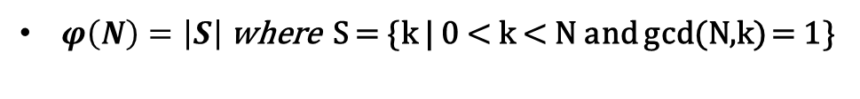
Euler’s Totient Function is the number of positive integers less than and relatively prime to N
$φ\left(N\right)=\left|S\right|$ where S = {k | 0 < k < N and gcd(N,k) = 1}
INSERT
VIDEO
HERE

Slide 3
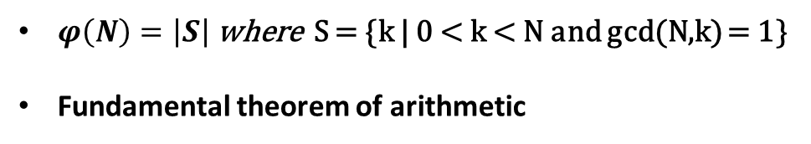
Euler’s Totient Function is the number of positive integers less than and relatively prime to N
$φ\left(N\right)=\left|S\right|$ where S = {k | 0 < k < N and gcd(N,k) = 1}
Fundamental theorem of arithmetic
INSERT
VIDEO
HERE

Slide 4
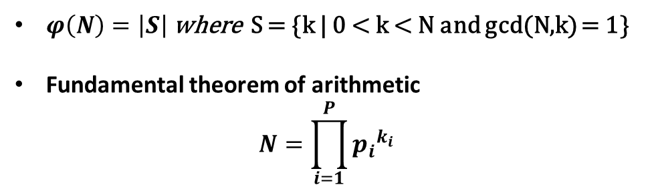
Euler’s Totient Function is the number of positive integers less than and relatively prime to N
$φ\left(N\right)=\left|S\right|$ where S = {k | 0 < k < N and gcd(N,k) = 1}
Fundamental theorem of arithmetic
$$N=\prod_{i=1}^{P}{{p_{i}}^{k_{i}}}$$
INSERT
VIDEO
HERE

Slide 5
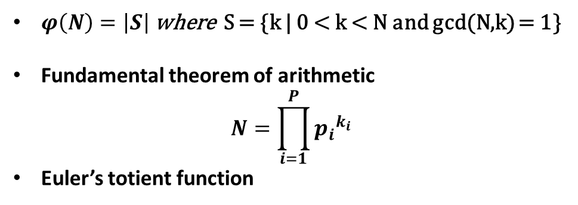
Euler’s Totient Function is the number of positive integers less than and relatively prime to N
$φ\left(N\right)=\left|S\right|$ where S = {k | 0 < k < N and gcd(N,k) = 1}
Fundamental theorem of arithmetic
$$N=\prod_{i=1}^{P}{{p_{i}}^{k_{i}}}$$
Euler’s totient function
INSERT
VIDEO
HERE

Slide 6
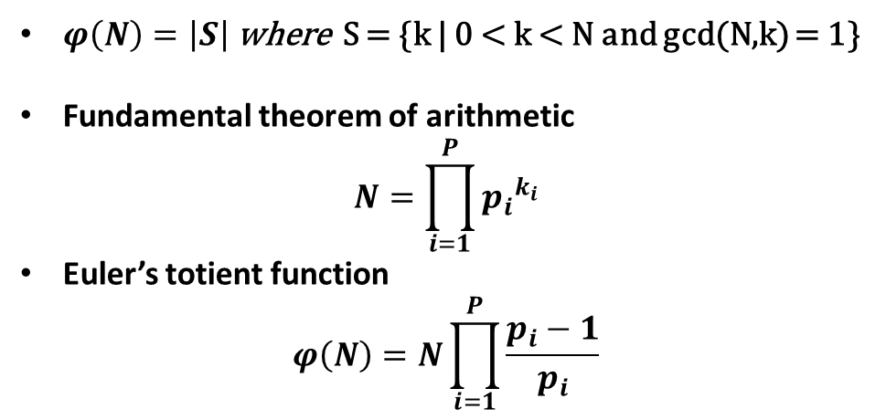
Euler’s Totient Function is the number of positive integers less than and relatively prime to N
$φ\left(N\right)=\left|S\right|$ where S = {k | 0 < k < N and gcd(N,k) = 1}
Fundamental theorem of arithmetic
$$N=\prod_{i=1}^{P}{{p_{i}}^{k_{i}}}$$
Euler’s totient function
$$φ\left(N\right)=N\prod_{i=1}^{P}{\frac{p_{i}−1}{p_{i}}}$$
INSERT
VIDEO
HERE

Slide 7
Totient of a prime, p, is simply (p-1)
INSERT
VIDEO
HERE

Slide 8

Totient of a prime, p, is simply (p-1)
$$φ\left(p\right)=p\prod_{i=1}^{1}{\frac{p_{i}−1}{p_{i}}}=p−1$$
INSERT
VIDEO
HERE

Slide 9
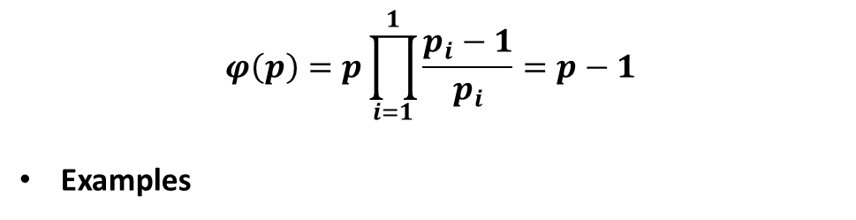
Totient of a prime, p, is simply (p-1)
$$φ\left(p\right)=p\prod_{i=1}^{1}{\frac{p_{i}−1}{p_{i}}}=p−1$$
Examples
INSERT
VIDEO
HERE

Slide 10
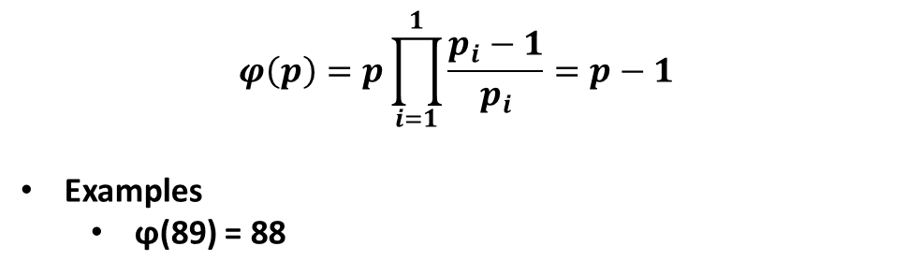
Totient of a prime, p, is simply (p-1)
$$φ\left(p\right)=p\prod_{i=1}^{1}{\frac{p_{i}−1}{p_{i}}}=p−1$$
Examples
ϕ(89) = 88
INSERT
VIDEO
HERE

Slide 11
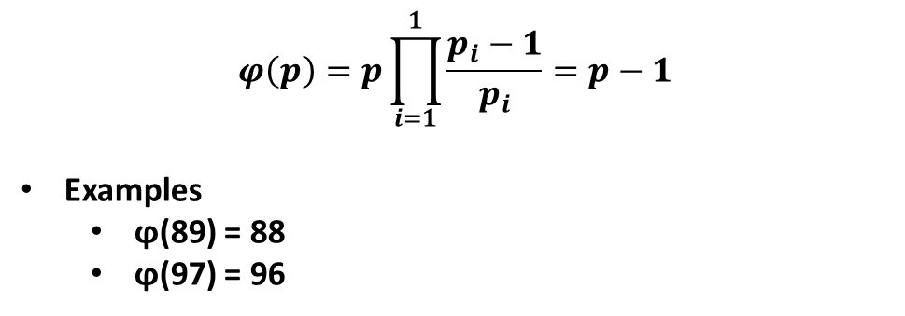
Totient of a prime, p, is simply (p-1)
$$φ\left(p\right)=p\prod_{i=1}^{1}{\frac{p_{i}−1}{p_{i}}}=p−1$$
Examples
ϕ(89) = 88
ϕ(97) = 96
INSERT
VIDEO
HERE

Slide 12
Totient of a product of primes is the product of one less than each prime
INSERT
VIDEO
HERE

Slide 13
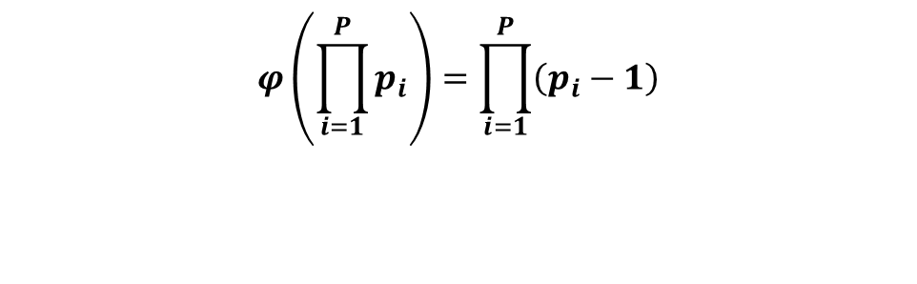
Totient of a product of primes is the product of one less than each prime
$$φ\left(\prod_{i=1}^{P}{p_{i}}\right)=\prod_{i=1}^{P}{\left(p_{i}−1\right)}$$
INSERT
VIDEO
HERE

Slide 14
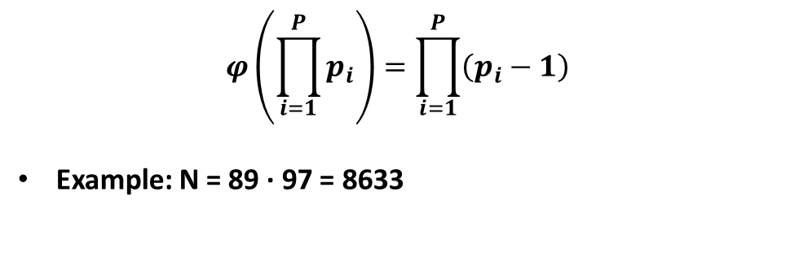
Totient of a product of primes is the product of one less than each prime
$$φ\left(\prod_{i=1}^{P}{p_{i}}\right)=\prod_{i=1}^{P}{\left(p_{i}−1\right)}$$
Example: N = 89 · 97 = 8633
INSERT
VIDEO
HERE

Slide 15
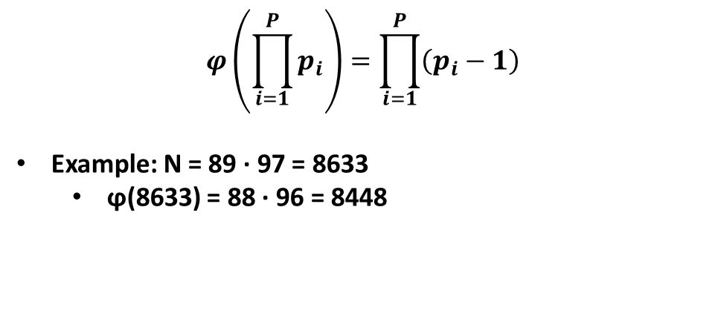
Totient of a product of primes is the product of one less than each prime
$$φ\left(\prod_{i=1}^{P}{p_{i}}\right)=\prod_{i=1}^{P}{\left(p_{i}−1\right)}$$
Example: N = 89 · 97 = 8633
ϕ(8633) = 88 · 96 = 8448
INSERT
VIDEO
HERE

Slide 16
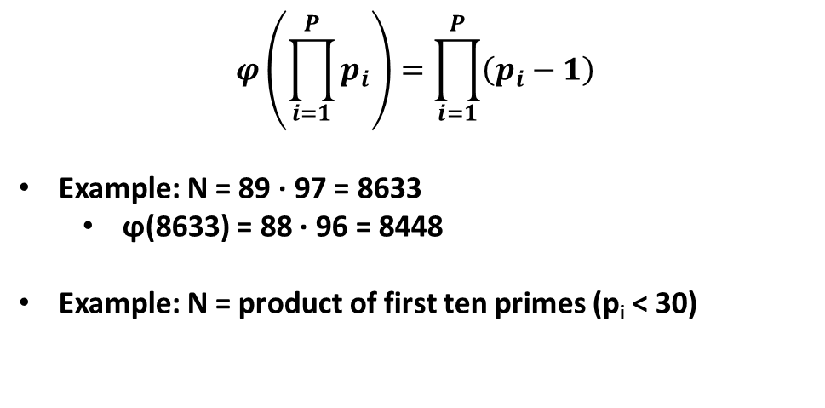
Totient of a product of primes is the product of one less than each prime
$$φ\left(\prod_{i=1}^{P}{p_{i}}\right)=\prod_{i=1}^{P}{\left(p_{i}−1\right)}$$
Example: N = 89 · 97 = 8633
ϕ(8633) = 88 · 96 = 8448
Example: N = product of first ten primes (p_{i} < 30)
INSERT
VIDEO
HERE

Slide 17
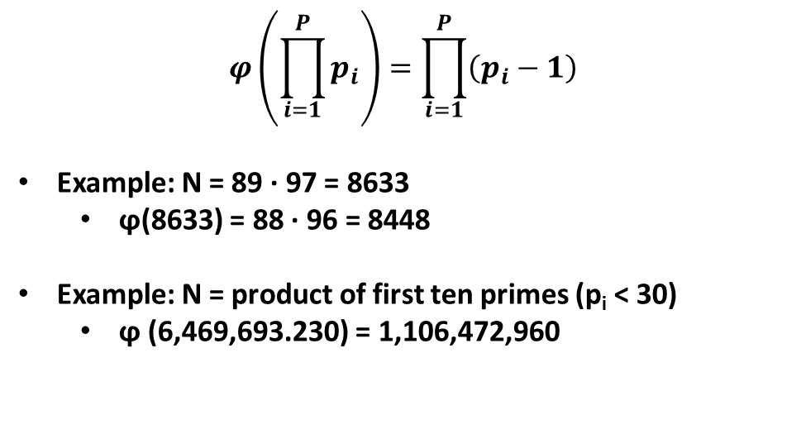
Totient of a product of primes is the product of one less than each prime
$$φ\left(\prod_{i=1}^{P}{p_{i}}\right)=\prod_{i=1}^{P}{\left(p_{i}−1\right)}$$
Example: N = 89 · 97 = 8633
ϕ(8633) = 88 · 96 = 8448
Example: N = product of first ten primes (p_{i} < 30)
ϕ (6,469,693.230) = 1,106,472,960
INSERT
VIDEO
HERE

Slide 18
Totient of a prime power is a simple fraction of the value of the number
INSERT
VIDEO
HERE

Slide 19
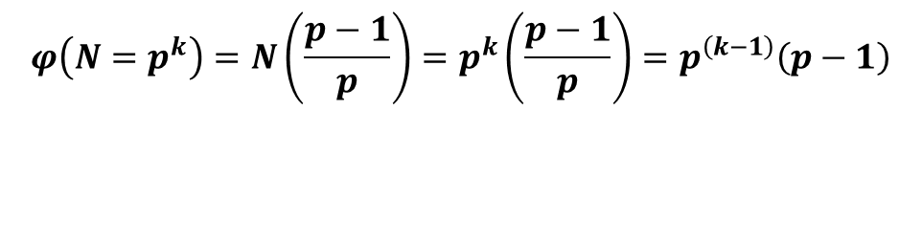
Totient of a prime power is a simple fraction of the value of the number
$$φ\left({N=p}^{k}\right)=N\left(\frac{p−1}{p}\right)=p^{k}\left(\frac{p−1}{p}\right)=p^{\left(k−1\right)}\left(p−1\right)$$
INSERT
VIDEO
HERE

Slide 20
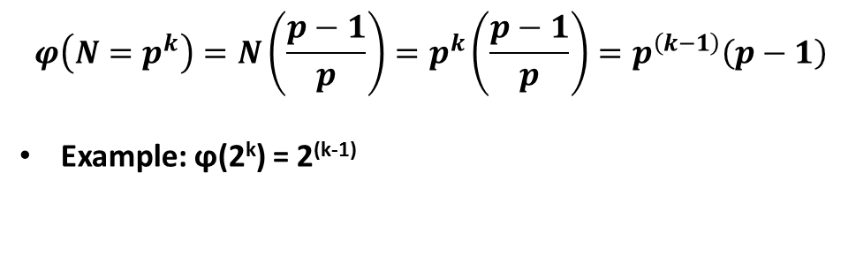
Totient of a prime power is a simple fraction of the value of the number
$$φ\left({N=p}^{k}\right)=N\left(\frac{p−1}{p}\right)=p^{k}\left(\frac{p−1}{p}\right)=p^{\left(k−1\right)}\left(p−1\right)$$
Example: ϕ(2^{k}) = 2^{(k-1)}
INSERT
VIDEO
HERE

Slide 21
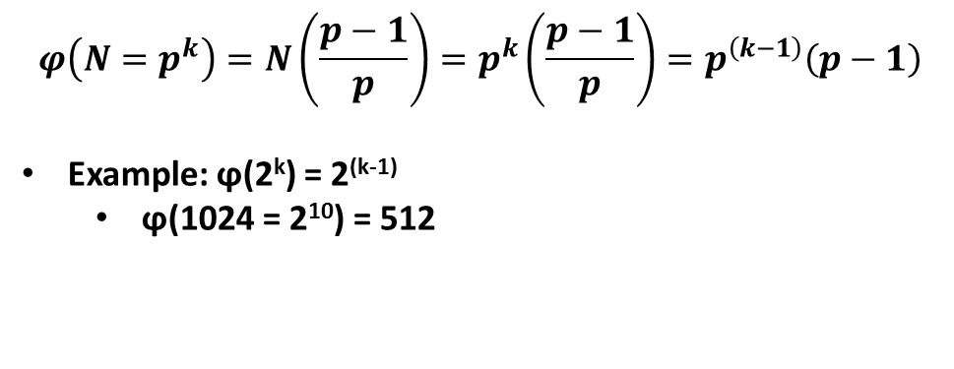
Totient of a prime power is a simple fraction of the value of the number
$$φ\left({N=p}^{k}\right)=N\left(\frac{p−1}{p}\right)=p^{k}\left(\frac{p−1}{p}\right)=p^{\left(k−1\right)}\left(p−1\right)$$
Example: ϕ(2^{k}) = 2^{(k-1)}
ϕ(1024 = 2¹⁰) = 512
INSERT
VIDEO
HERE

Slide 22
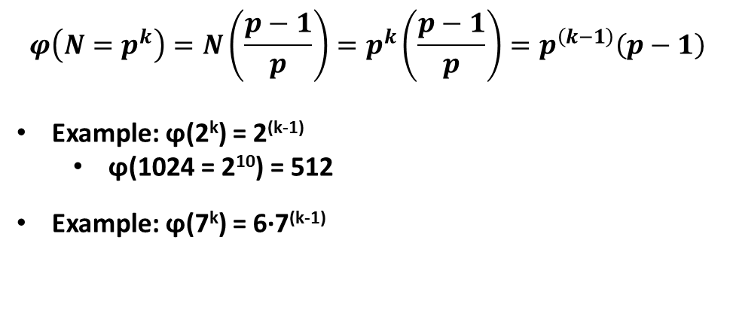
Totient of a prime power is a simple fraction of the value of the number
$$φ\left({N=p}^{k}\right)=N\left(\frac{p−1}{p}\right)=p^{k}\left(\frac{p−1}{p}\right)=p^{\left(k−1\right)}\left(p−1\right)$$
Example: ϕ(2^{k}) = 2^{(k-1)}
ϕ(1024 = 2¹⁰) = 512
Example: ϕ(7^{k}) = 6·7^{(k-1)}
INSERT
VIDEO
HERE

Slide 23
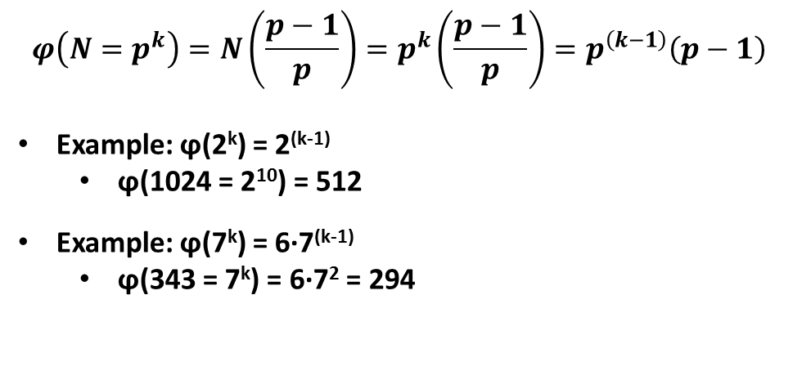
Totient of a prime power is a simple fraction of the value of the number
$$φ\left({N=p}^{k}\right)=N\left(\frac{p−1}{p}\right)=p^{k}\left(\frac{p−1}{p}\right)=p^{\left(k−1\right)}\left(p−1\right)$$
Example: ϕ(2^{k}) = 2^{(k-1)}
ϕ(1024 = 2¹⁰) = 512
Example: ϕ(7^{k}) = 6·7^{(k-1)}
ϕ(343 = 7^{k}) = 6·7² = 294
INSERT
VIDEO
HERE

Slide 24
Totient of an arbitrary number is the product of the totient of the prime powers
INSERT
VIDEO
HERE

Slide 25

Totient of an arbitrary number is the product of the totient of the prime powers
$$φ\left(N\right)=N\prod_{i=1}^{P}{\frac{p_{i}−1}{p_{i}}}=\prod_{i=1}^{P}{p^{k}\frac{p_{i}−1}{p_{i}}}=\prod_{i=1}^{P}{φ\left(p^{k}\right)}$$
INSERT
VIDEO
HERE

Slide 26
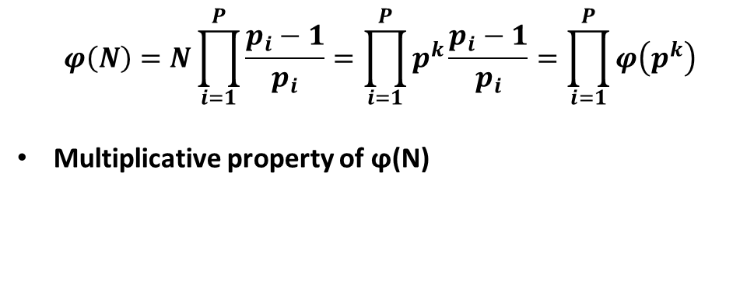
Totient of an arbitrary number is the product of the totient of the prime powers
$$φ\left(N\right)=N\prod_{i=1}^{P}{\frac{p_{i}−1}{p_{i}}}=\prod_{i=1}^{P}{p^{k}\frac{p_{i}−1}{p_{i}}}=\prod_{i=1}^{P}{φ\left(p^{k}\right)}$$
Multiplicative property of ϕ(N)
INSERT
VIDEO
HERE

Slide 27
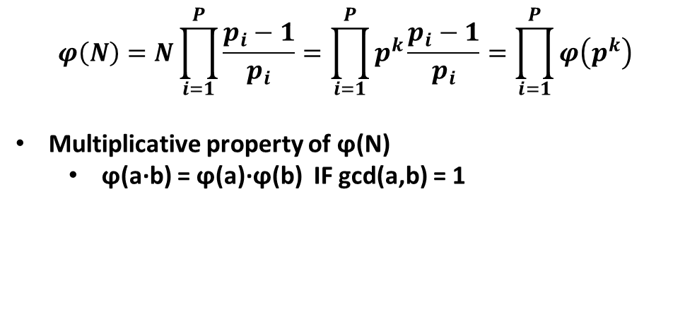
Totient of an arbitrary number is the product of the totient of the prime powers
$$φ\left(N\right)=N\prod_{i=1}^{P}{\frac{p_{i}−1}{p_{i}}}=\prod_{i=1}^{P}{p^{k}\frac{p_{i}−1}{p_{i}}}=\prod_{i=1}^{P}{φ\left(p^{k}\right)}$$
Multiplicative property of ϕ(N)
ϕ(a·b) = ϕ(a)·ϕ(b) IF gcd(a,b) = 1
INSERT
VIDEO
HERE

Slide 28
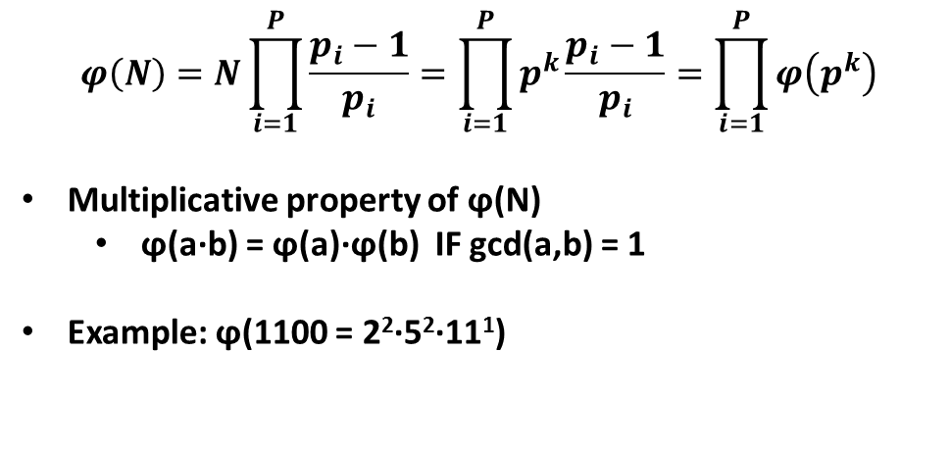
Totient of an arbitrary number is the product of the totient of the prime powers
$$φ\left(N\right)=N\prod_{i=1}^{P}{\frac{p_{i}−1}{p_{i}}}=\prod_{i=1}^{P}{p^{k}\frac{p_{i}−1}{p_{i}}}=\prod_{i=1}^{P}{φ\left(p^{k}\right)}$$
Multiplicative property of ϕ(N)
ϕ(a·b) = ϕ(a)·ϕ(b) IF gcd(a,b) = 1
Example: ϕ(1100 = 2²·5²·11¹)
INSERT
VIDEO
HERE

Slide 29
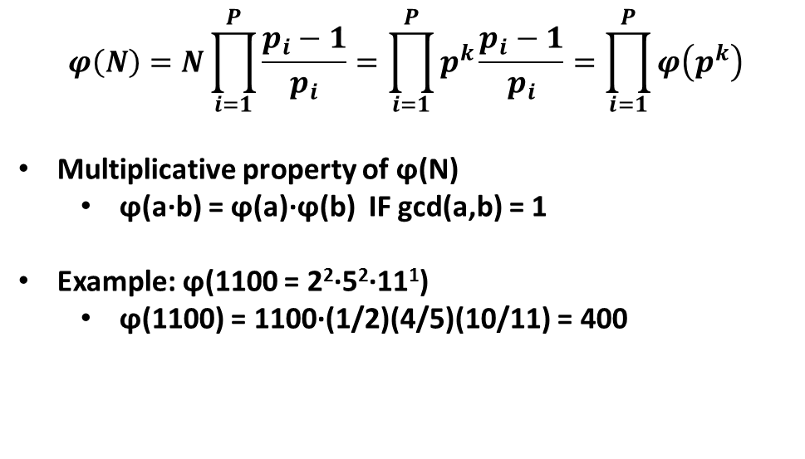
Totient of an arbitrary number is the product of the totient of the prime powers
$$φ\left(N\right)=N\prod_{i=1}^{P}{\frac{p_{i}−1}{p_{i}}}=\prod_{i=1}^{P}{p^{k}\frac{p_{i}−1}{p_{i}}}=\prod_{i=1}^{P}{φ\left(p^{k}\right)}$$
Multiplicative property of ϕ(N)
ϕ(a·b) = ϕ(a)·ϕ(b) IF gcd(a,b) = 1
Example: ϕ(1100 = 2²·5²·11¹)
ϕ(1100) = 1100·(1/2)(4/5)(10/11) = 400
INSERT
VIDEO
HERE

Slide 30
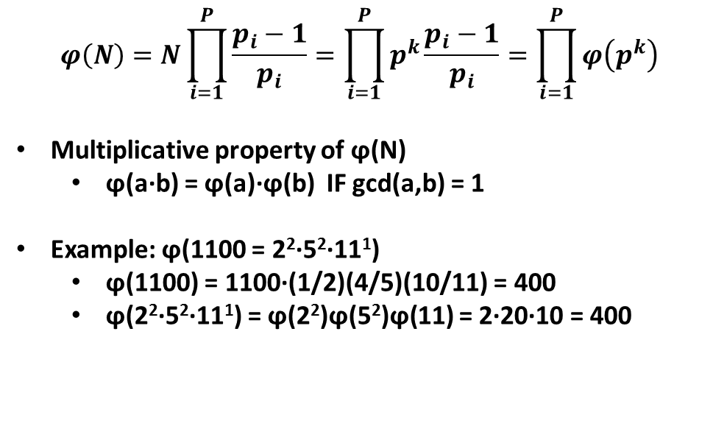
Totient of an arbitrary number is the product of the totient of the prime powers
$$φ\left(N\right)=N\prod_{i=1}^{P}{\frac{p_{i}−1}{p_{i}}}=\prod_{i=1}^{P}{p^{k}\frac{p_{i}−1}{p_{i}}}=\prod_{i=1}^{P}{φ\left(p^{k}\right)}$$
Multiplicative property of ϕ(N)
ϕ(a·b) = ϕ(a)·ϕ(b) IF gcd(a,b) = 1
Example: ϕ(1100 = 2²·5²·11¹)
ϕ(1100) = 1100·(1/2)(4/5)(10/11) = 400
ϕ(2²·5²·11¹) = ϕ(2²)ϕ(5²)ϕ(11) = 2·20·10 = 400
INSERT
VIDEO
HERE

Slide 31
Proof of Totient formula requires proof of just two special cases
$$φ\left(N\right)=N\prod_{i=1}^{P}{\frac{p_{i}−1}{p_{i}}}=\prod_{i=1}^{P}{p^{k}\frac{p_{i}−1}{p_{i}}}=\prod_{i=1}^{P}{φ\left(p^{k}\right)}$$
INSERT
VIDEO
HERE

Slide 32
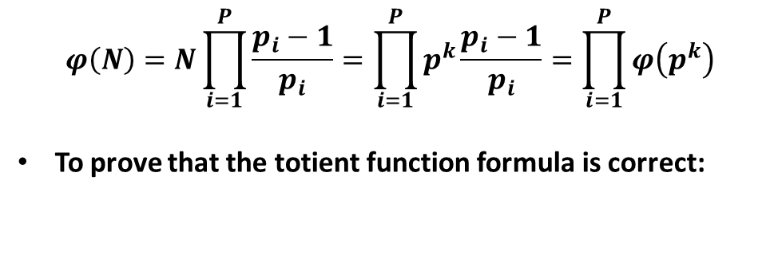
Proof of Totient formula requires proof of just two special cases
$$φ\left(N\right)=N\prod_{i=1}^{P}{\frac{p_{i}−1}{p_{i}}}=\prod_{i=1}^{P}{p^{k}\frac{p_{i}−1}{p_{i}}}=\prod_{i=1}^{P}{φ\left(p^{k}\right)}$$
To prove that the totient function formula is correct:
INSERT
VIDEO
HERE

Slide 33
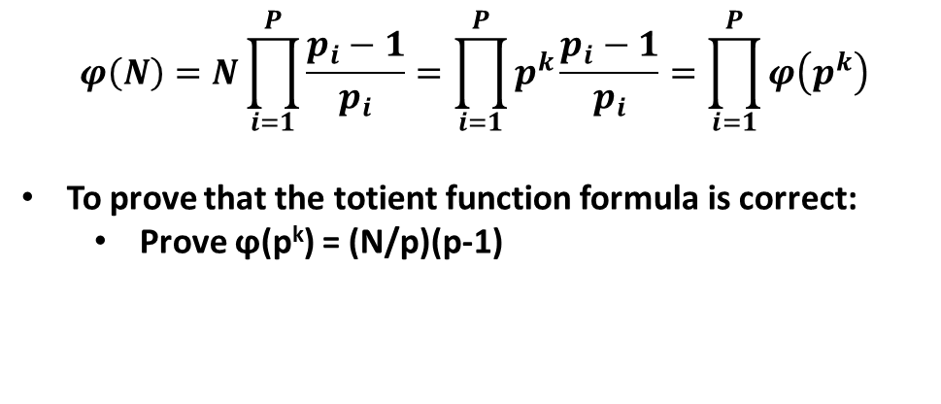
Proof of Totient formula requires proof of just two special cases
$$φ\left(N\right)=N\prod_{i=1}^{P}{\frac{p_{i}−1}{p_{i}}}=\prod_{i=1}^{P}{p^{k}\frac{p_{i}−1}{p_{i}}}=\prod_{i=1}^{P}{φ\left(p^{k}\right)}$$
To prove that the totient function formula is correct:
Prove ϕ(p^{k}) = (N/p)(p-1)
INSERT
VIDEO
HERE

Slide 34
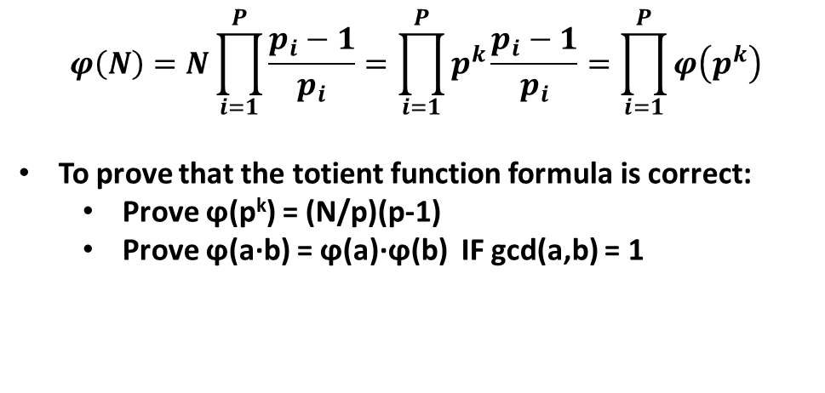
Proof of Totient formula requires proof of just two special cases
$$φ\left(N\right)=N\prod_{i=1}^{P}{\frac{p_{i}−1}{p_{i}}}=\prod_{i=1}^{P}{p^{k}\frac{p_{i}−1}{p_{i}}}=\prod_{i=1}^{P}{φ\left(p^{k}\right)}$$
To prove that the totient function formula is correct:
Prove ϕ(p^{k}) = (N/p)(p-1)
Prove ϕ(a·b) = ϕ(a)·ϕ(b) IF gcd(a,b) = 1
INSERT
VIDEO
HERE

Slide 35
To find totient of N=p^{k}, subtract number of multiples of p from number of positive integers less than N
INSERT
VIDEO
HERE

Slide 36
To find totient of N=p^{k}, subtract number of multiples of p from number of positive integers less than N
Number of candidates is N-1 (i.e., 1 ≤ x ≤ N)
INSERT
VIDEO
HERE

Slide 37
To find totient of N=p^{k}, subtract number of multiples of p from number of positive integers less than N
Number of candidates is N-1 (i.e., 1 ≤ x ≤ N)
Count how many values of x for which gcd(x,N) > 1
INSERT
VIDEO
HERE

Slide 38
To find totient of N=p^{k}, subtract number of multiples of p from number of positive integers less than N
Number of candidates is N-1 (i.e., 1 ≤ x ≤ N)
Count how many values of x for which gcd(x,N) > 1
gcd(x,N) > 1 only if x = m·p for (1 ≤ m < N/p)
INSERT
VIDEO
HERE

Slide 39
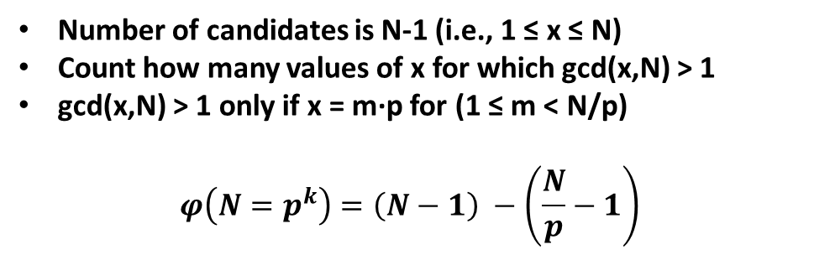
To find totient of N=p^{k}, subtract number of multiples of p from number of positive integers less than N
Number of candidates is N-1 (i.e., 1 ≤ x ≤ N)
Count how many values of x for which gcd(x,N) > 1
gcd(x,N) > 1 only if x = m·p for (1 ≤ m < N/p)
$$φ\left(N=p^{k}\right)=\left(N−1\right) −\left(\frac{N}{p}−1\right)$$
INSERT
VIDEO
HERE

Slide 40
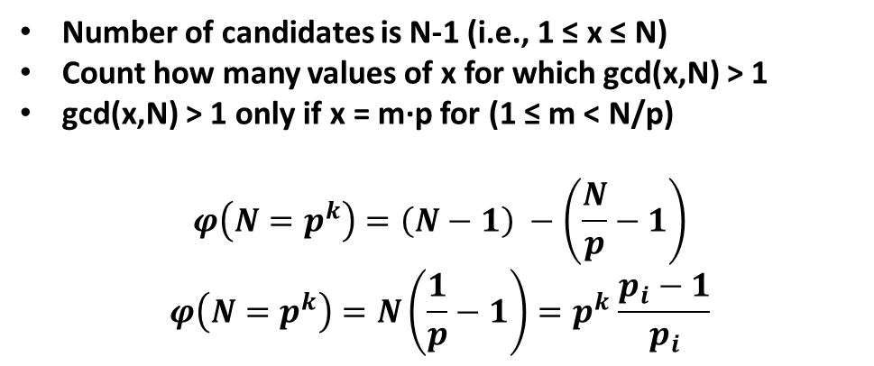
To find totient of N=p^{k}, subtract number of multiples of p from number of positive integers less than N
Number of candidates is N-1 (i.e., 1 ≤ x ≤ N)
Count how many values of x for which gcd(x,N) > 1
gcd(x,N) > 1 only if x = m·p for (1 ≤ m < N/p)
$$φ\left(N=p^{k}\right)=\left(N−1\right) −\left(\frac{N}{p}−1\right)$$
$$φ\left(N=p^{k}\right)=N\left(\frac{1}{p}−1\right){=p}^{k}\frac{p_{i}−1}{p_{i}}$$
INSERT
VIDEO
HERE

Slide 41
To find totient of N=PQ, identify groups of integers that are relatively prime to N
INSERT
VIDEO
HERE

Slide 42
To find totient of N=PQ, identify groups of integers that are relatively prime to N
Create table of all x | 0 ≤ x < N
INSERT
VIDEO
HERE

Slide 43
To find totient of N=PQ, identify groups of integers that are relatively prime to N
Create table of all x | 0 ≤ x < N
x = qP+p with 0 ≤ q < Q; 0 ≤ p < P
INSERT
VIDEO
HERE

Slide 44
To find totient of N=PQ, identify groups of integers that are relatively prime to N
Create table of all x | 0 ≤ x < N
x = qP+p with 0 ≤ q < Q; 0 ≤ p < P
| 0 1 2 ... q ... (Q-1) _
0 | 0 P 2P qP (Q-1)P
1 | 1 P+1 2P+1 qP+1 (Q-1)P+1
2 | 2 P+2 2P+2 qP+2 (Q-1)P+2
... |
p | 3 P+3 2P+3 qP+p (Q-1)P+p
... |
P-1 | P-1 2P-1 3P-1 (q+1)P-1 QP-1
INSERT
VIDEO
HERE

Slide 45
Eliminate rows containing no values relatively prime to N, then eliminate elements in the remaining rows
INSERT
VIDEO
HERE

Slide 46
Eliminate rows containing no values relatively prime to N, then eliminate elements in the remaining rows
Choose p that is NOT relatively prime to P
INSERT
VIDEO
HERE

Slide 47
Eliminate rows containing no values relatively prime to N, then eliminate elements in the remaining rows
Choose p that is NOT relatively prime to P
gcd(p, P) = c; p = cp’; P = cP’
INSERT
VIDEO
HERE

Slide 48
Eliminate rows containing no values relatively prime to N, then eliminate elements in the remaining rows
Choose p that is NOT relatively prime to P
gcd(p, P) = c; p = cp’; P = cP’
x = qP + p = qcP’ + cp; = c(qP’ + p’)
INSERT
VIDEO
HERE

Slide 49
Eliminate rows containing no values relatively prime to N, then eliminate elements in the remaining rows
Choose p that is NOT relatively prime to P
gcd(p, P) = c; p = cp’; P = cP’
x = qP + p = qcP’ + cp; = c(qP’ + p’)
Every integer on row p shares a factor with P, and hence N
INSERT
VIDEO
HERE

Slide 50
Eliminate rows containing no values relatively prime to N, then eliminate elements in the remaining rows
Choose p that is NOT relatively prime to P
gcd(p, P) = c; p = cp’; P = cP’
x = qP + p = qcP’ + cp; = c(qP’ + p’)
Every integer on row p shares a factor with P, and hence N
Number of rows left is equal to ϕ(P)
INSERT
VIDEO
HERE

Slide 51
Eliminate rows containing no values relatively prime to N, then eliminate elements in the remaining rows
Choose p that is NOT relatively prime to P
gcd(p, P) = c; p = cp’; P = cP’
x = qP + p = qcP’ + cp; = c(qP’ + p’)
Every integer on row p shares a factor with P, and hence N
Number of rows left is equal to ϕ(P)
On each row, we add P to prior entry
INSERT
VIDEO
HERE

Slide 52
Eliminate rows containing no values relatively prime to N, then eliminate elements in the remaining rows
Choose p that is NOT relatively prime to P
gcd(p, P) = c; p = cp’; P = cP’
x = qP + p = qcP’ + cp; = c(qP’ + p’)
Every integer on row p shares a factor with P, and hence N
Number of rows left is equal to ϕ(P)
On each row, we add P to prior entry
P & Q are relatively prime, Q columns
INSERT
VIDEO
HERE

Slide 53
Eliminate rows containing no values relatively prime to N, then eliminate elements in the remaining rows
Choose p that is NOT relatively prime to P
gcd(p, P) = c; p = cp’; P = cP’
x = qP + p = qcP’ + cp; = c(qP’ + p’)
Every integer on row p shares a factor with P, and hence N
Number of rows left is equal to ϕ(P)
On each row, we add P to prior entry
P & Q are relatively prime, Q columns
Each residue mod-Q appears exactly once in each row
INSERT
VIDEO
HERE

Slide 54
Eliminate rows containing no values relatively prime to N, then eliminate elements in the remaining rows
Choose p that is NOT relatively prime to P
gcd(p, P) = c; p = cp’; P = cP’
x = qP + p = qcP’ + cp; = c(qP’ + p’)
Every integer on row p shares a factor with P, and hence N
Number of rows left is equal to ϕ(P)
On each row, we add P to prior entry
P & Q are relatively prime, Q columns
Each residue mod-Q appears exactly once in each row
Number of elements relatively prime to N is ϕ(Q)
INSERT
VIDEO
HERE

Slide 55
Eliminate rows containing no values relatively prime to N, then eliminate elements in the remaining rows
Choose p that is NOT relatively prime to P
gcd(p, P) = c; p = cp’; P = cP’
x = qP + p = qcP’ + cp; = c(qP’ + p’)
Every integer on row p shares a factor with P, and hence N
Number of rows left is equal to ϕ(P)
On each row, we add P to prior entry
P & Q are relatively prime, Q columns
Each residue mod-Q appears exactly once in each row
Number of elements relatively prime to N is ϕ(Q)
ϕ(N) = ϕ(P)·ϕ(Q)
INSERT
VIDEO
HERE

Slide 56
Eliminate rows containing no values relatively prime to N, then eliminate elements in the remaining rows
Choose p that is NOT relatively prime to P
gcd(p, P) = c; p = cp’; P = cP’
x = qP + p = qcP’ + cp; = c(qP’ + p’)
Every integer on row p shares a factor with P, and hence N
Number of rows left is equal to ϕ(P)
On each row, we add P to prior entry
P & Q are relatively prime, Q columns
Each residue mod-Q appears exactly once in each row
Number of elements relatively prime to N is ϕ(Q)
ϕ(N) = ϕ(P)·ϕ(Q)
Can general to any number of relatively prime factors.
INSERT
VIDEO
HERE

